Slide 1
Sales and Profit Analysis Dashboard
Tool: Power BI
Dataset: Superstore Dataset
Name: Tetali Durga Venkata Reddy
Email:tetalidurgavenkatareddy@gmail.com

Slide 2
Objectives
Analyze Sales performance across regions, segments, and categories.
Understand Trends over time using time-series analysis.Identify Top and Bottom performing sub-categories.
Monitor KPIs like Total Sales and Growth.
Enable interactive filtering by Region, Category, and Segment.

Slide 3
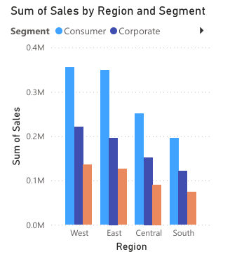
Bar Chart: Sum of Sales by Region and Segment
Compares total sales across Regions (West, East, Central, South) split by Segments (Consumer, Corporate, Home Office).
The West and East regions have the highest sales, mainly driven by the Consumer segment.

Slide 4
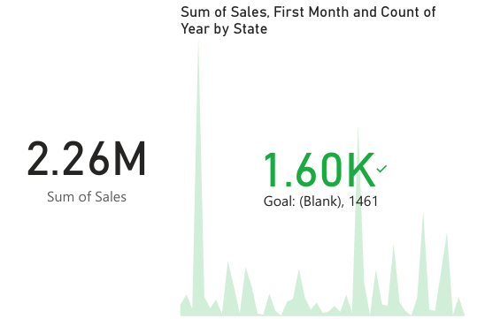
KPI Card: Total Sum of Sales
Highlights the Total Sales value of 2.26 Million.
Provides a quick summary of overall revenue performance.
Sales performance trend during the first month and how it varies by state across the year.
Some states show sharp sales peaks during the early months, indicating seasonal buying trends.

Slide 5
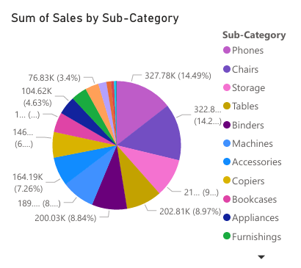
Pie Chart: Sum of Sales by Sub-Category
Sales distribution among different Sub-Categories (Phones, Chairs, Storage, Tables, etc.).
Phones are the top-selling sub-category (around 14.49% of total sales), followed by Chairs and Binders.

Slide 6
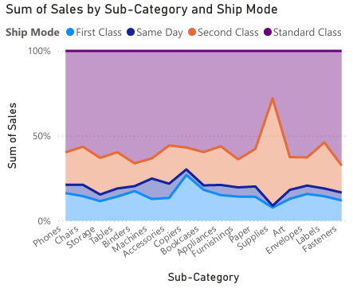
100% Stacked Area Chart: Sum of Sales by Sub-Category and Ship Mode
Shipping mode distribution (First Class, Same Day, Second Class, Standard Class) across different Sub-Categories.
Standard Class dominates the shipping for most categories, showing customers prefer economical shipping options.

Slide 7
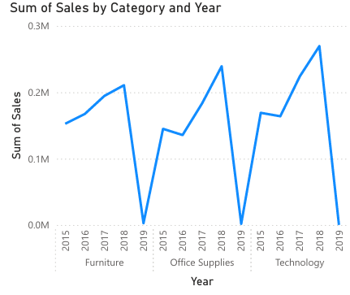
Line Chart: Sum of Sales by Category and Year
Year-over-year sales trends for Furniture, Office Supplies, and Technology.
Sales of Technology have seen strong peaks compared to other categories, showing it as a fast-growing segment.

Slide 8
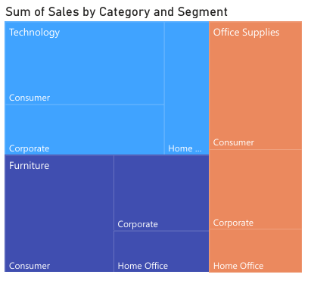
Tree Map: Sum of Sales by Category and Segment
Contribution of each Category (Furniture, Technology, Office Supplies) broken down by Segments (Consumer, Corporate, Home Office).
Technology - Consumer leads sales contribution, followed by Office Supplies - Consumer and Furniture - Consumer.

Slide 9
Thank you
--*--

